Slide 1
THE BROWN RECLUSE SPIDER
Student Name
Institution Affiliations
Date

Slide 2
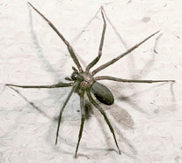
Organism Introduction
The common name of the spider is the brown spider or violin spider.
The scientific name of the brown recluse spider is the Loxosceles reclusa.
I observed the organism in the Central Texas state park while on a family trip.
The facts stated on the general information about the organisms capture my attention and so decided to do detailed research.
The Brown Recluse spider contains a necrotic venom, which can kill if the victim does not seek medical attention.
Interestingly, venom is also significant in the medical field.
Notes:
The common name of the spider is the brown spider or violin spider. The scientific name of the brown recluse spider is the Loxosceles reclusa. I observed the organism in the Central Texas state park while on a family trip. The facts stated on the general information about the organisms capture my attention and so decided to do detailed research. The Brown Recluse spider contains a necrotic venom, which can kill if the victim does not seek medical attention. Interestingly, venom is also significant in the medical field.

Slide 3
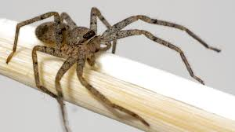
Physical Description
It grows to about 6mm to 20mm or even larger.
As the name goes, the recluse spider is brown
Some portray typical light brown color while others may be dark brown or even black.
They have varying colors in the cephalothorax and the abdomen with the dorsal side of the cephalothorax having black line-markings that resemble the violin. Hence the name, violin spider.
Some other spiders like pirate and cell spiders also have the same violin patterns.
Notes:
Physical Description
As the name goes, the recluse spider is brown and grows to about 6mm to 20mm or even larger. Some portray typical light brown color while others may be dark brown or even black. They have varying colors in the cephalothorax and the abdomen with the dorsal side of the cephalothorax having black line-markings that resemble the violin. Hence the name, violin spider. Some other spiders like pirate and cell spiders also have the same violin patterns. Therefore, for specific identification, the brown recluse spider has six eyes arranged in pairs instead of the normal eight eyes like other spiders (Vetter et al, 1999). Besides, the recluse has no coloration in the legs and the abdomen. There are no spines in the legs and the joints appear to be slightly lighter in color. The abdomen is covered with fine short hairs that appear as soft fur under magnification.

Slide 4
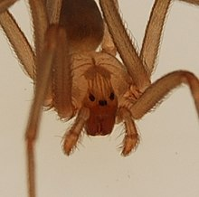
Specific Physical Description
For specific identification, the brown recluse spider has six eyes arranged in pairs (Vetter et al, 1999).
The recluse has no coloration in the legs and the abdomen. There are no spines in the legs and the joints appear to be slightly lighter in color.
The abdomen is covered with fine short hairs that appear as soft fur under magnification

Slide 5
Life Cycle
A recluse spider lives for about 2-3 years.
The female lays several egg sacs with about 50-300 eggs per sac.
In a few days (about four weeks), the eggs hatch, and the spiderlings take about a year to grow into adulthood.
The development of the spiderlings is influenced by environmental factors such as food and whether and they are capable of surviving for long periods without food and water.
Notes:
A recluse spider lives for about 2-3 years. The female lays several egg sacs with about 50-300 eggs per sac. In a few days (about four weeks), the eggs hatch, and the spiderlings take about a year to grow into adulthood. The development of the spiderlings is influenced by environmental factors such as food and whether and they are capable of surviving for long periods without food and water.

Slide 6
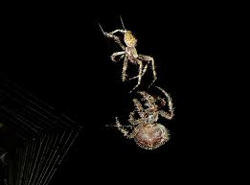
Reproduction
During mating seasons, especially springs, male recluse spiders feel their palp with sperm and seek the female mates.
When the female accepts the love package, they make their egg sacs.
the female secretes about 50 fertilized eggs at a time in a mass of liquid silk.
Once the eggs are laid, the female does not venture away from the nest and stays close to guard the eggs and the emergent spiderlings.
The gestation period is about 30 days but may change with the weather. In summer, the eggs spun.
(Angela Libal)
Notes:
During mating seasons, especially springs, male recluse spiders feel their palp with sperm and seek the female mates. When the female accepts the love package, they make their egg sacs. According to (Libal), the female secretes about 50 fertilized eggs at a time in a mass of liquid silk. Once the eggs are laid, the female does not venture away from the nest and stays close to guard the eggs and the emergent spiderlings. The gestation period is about 30 days but may change with the weather. In summer, the eggs spun.

Slide 7
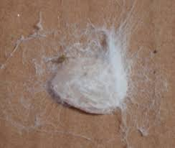
Reproduction (Cont.)
The female secretes about 50 fertilized eggs at a time in a mass of liquid silk.
Once the eggs are laid, the female does not venture away from the nest and stays close to guard the eggs and the emergent spiderlings.
The gestation period is about 30 days but may change with the weather. In summer, the eggs spun

Slide 8
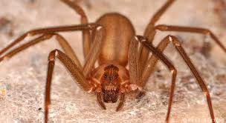
Structure and Function of the fangs
The most interesting part of why I chose this organism is because of its venom.
The venom is injected into the victims through tiny fangs, which cannot penetrate clothing, gloves, and socks, and under gametes.
Notes:
The most interesting part of why I chose this organism is because of its venom. The venom is injected into the victims through tiny fangs, which cannot penetrate clothing, gloves, and socks, and under gametes.

Slide 9
Habitat
The ecological distribution of the Loxosceles reclusa in the US is mainly in the Southern and Central parts of the country. They are rare outside these native ranges
The brown recluse spider is a very secluded animal and lives outdoors within the natural environment.
Like many other species of spiders, the brown recluse spider lives in a web constructed asymmetrically in woodpiles, rocks, debris, and sheds.
They are also well adapted in dwelling in human residents and build their webs in cardboards.
They are resilient enough in withstanding winters in unheated house basements.
Notes:
The ecological distribution of the Loxosceles reclusa in the US is mainly in the Southern and Central parts of the country. They are rare outside these native ranges
The brown recluse spider is a very secluded animal and lives outdoors within the natural environment. Like many other species of spiders, the brown recluse spider lives in a web constructed asymmetrically in woodpiles, rocks, debris, and sheds. They are also well adapted in dwelling in human residents and build their webs in cardboards. They are resilient enough in withstanding winters in unheated house basements.

Slide 10
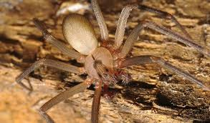
Habitat (Cont.)
Like many other species of spiders, the brown recluse spider lives in a web constructed asymmetrically in woodpiles, rocks, debris, and sheds. They are also well adapted in dwelling in human residents and build their webs in cardboards.
They are resilient enough in withstanding winters in unheated house basements.

Slide 11
Conclusion
There are many species of spiders in the world and over 3000 different species in the United States only (Rod and Ken Preston, 2984).
The Brown Recluse spider is one of the spiders in the region with the deadliest venoms if the victims fail to get medical assistance.
In the US, they are ecologically distributed within the central and southern parts of America.
The female lays about 100 – 300 fertilized eggs contained in about 50 egg sacs.
The eggs hatch in about four weeks and the spiderlings mature and attain adulthood in less than a year.
The Adult Recluse Spider lives for two years less or more depending on the environment whether conditions.
Notes:
There are many species of spiders in the world and over 3000 different species in the United States only (Rod and Ken Preston, 2984). The Brown Recluse spider is one of the spiders in the region with the deadliest venoms if the victims fail to get medical assistance. In the US, they are ecologically distributed within the central and southern parts of America. The female lays about 100 – 300 fertilized eggs contained in about 50 egg sacs. The eggs hatch in about four weeks and the spiderlings mature and attain adulthood in less than a year. The Brown Recluse Spider lives for two years less or more depending on the environment whether conditions. The brown recluse spider is dangerous to humans live when they bite and inject venoms. But, on the contrary, they occupy the most important niche in the food web since they regulate the population of their prey species such as mosquitos. In conclusion, the Recluse spider through its bite has aided medical professionals in proper identification and treatment of other spider bites (Saupe et al, 2011)

Slide 12
Conclusion (Cont.)
The brown recluse spider is dangerous to humans live when they bite and inject venoms.
But, on the contrary, they occupy the most important niche in the food web since they regulate the population of their prey species such as mosquitos.
In conclusion, the Recluse spider through its bite has aided medical professionals in proper identification and treatment of other spider bites (Saupe et al, 2011)

Slide 13
References
Vetter R; Shay, M; Bitterman, O (1999). "Identifying and misidentifying the brown recluse spider". Dermatol Online J. 5 (2): 7. doi:10.2340/00015555-0082. PMID 10673460.
Angela Libal. The Gestation Period of a Brown Recluse Spider. Accessed [Online] at https://animals.mom.com/gestation-period-brown-recluse-spider-8878.html
Saupe, E. E., Papes, M., Selden, P. A., & Vetter, R. S. (2011). Tracking a medically important spider: climate change, ecological niche modeling, and the brown recluse (Loxosceles reclusa). PloS one, 6(3), e17731.
Preston-Mafham, R., & Preston-Mafham, K. (1993). The encyclopedia of land invertebrate behavior. MIT Press. Accessed [online] at http://www.explorit.org/science/spider.html

